Slide 1
App Store Data Challenge
By: Jason Yang
Friday, March 4th, 2022

Slide 2
Executive Summary
Opportunity in providing free app downloads to PMOF accounts

Slide 3
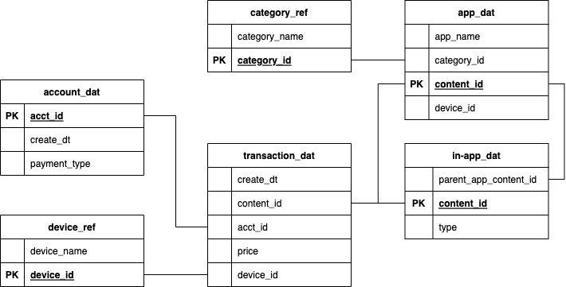
Schema Diagram

Slide 6
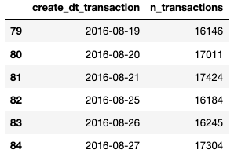
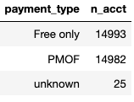
Data Quality Issues
25 acct_id’s without payment_type
data gap on 2016-08-22 to 2016-08-24

